Slide 1
Sons of God:
Knowing Him as our Father
Acts 13:22, Ps 103
18/03/17

Slide 2
Gal 4:1-9
⁷ Therefore you are no longer a slave but a son, and if a son, then an heir of God through Christ.
⁸ But then, indeed, when you did not know God, you served those which by nature are not gods.
⁹ But now after you have known God, or rather are known by God, how is it that you turn again to the weak and beggarly elements, to which you desire again to be in bondage?

Slide 3
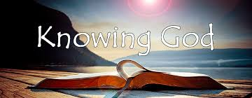
And this is eternal life, that they may
know You, the only true God, and
Jesus Christ whom You have sent.
John 17:3

Slide 4
Do we know Him outwardly (flesh) or know Him inwardly (Spirit)?
Psalm 103:7
He made known His ways to Moses,
His acts to the children of Israel.
2 Cor. 5:16
Therefore, from now on, we regard no one according to the flesh. Even though we have known Christ according to the flesh, yet now we know Him thus no longer.”

Slide 5

Acts 13:22
And when He had removed him,
He raised up for them David as king,
to whom also He gave testimony and said,
‘I have found David the son of Jesse,
a man after My own heart,
who will do all My will.

Slide 6


Know God as our:
Saviour
2) Father
3) King

Slide 7

“The blood of Jesus was not
shed merely to save us from
our sins, but to restore us to a
relationship with God in which we partner with Him as kings
and priests to bring the planet under His rule and reign. We
have delegated authority to
establish His Kingdom wherever the sole of our foot treads.”

Slide 8
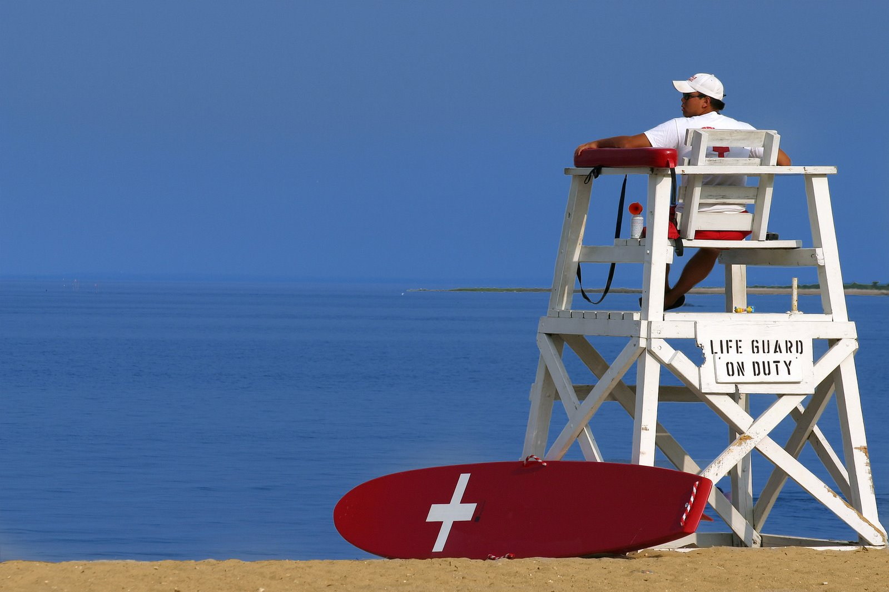
1) Know God as our Saviour
Not only from judgement (hell):
Ps 103:3-4 Also from diseases & destruction.
Gal 5:1 - Stand fast therefore in the liberty by which Christ has made us free, and do not be entangled again with a yoke of bondage.
Enables us to walk in righteousness
Rom 6:18-19 And having been set free from sin, you became slaves of righteousness. … so now present your members as slaves of righteousness for holiness.

Slide 9
We are saved into His Kingdom
Enable us to walk in light
Col 1:13-14 - He has delivered us from the power of darkness and conveyed us into the kingdom of the Son of His love, in whom we have redemption through His blood, the forgiveness of sins.
Enables us to walk in the Spirit
Gal 5:22-25 - But the fruit of the Spirit is love, joy, peace, longsuffering, kindness, goodness, faithfulness, gentleness, self-control. Against such there is no law. And those who are Christ’s have crucified the flesh with its passions and desires. If we live in the Spirit, let us also walk in the Spirit.

Slide 10
We are saved into His family (body)
1 Cor 12 :13 - For as the body is one and has many members, but all the members of that one body, being many, are one body, so also is Christ. For by one Spirit we were all baptized into one body—whether Jews or Greeks, whether slaves or free—and have all been made to drink into one Spirit.

Slide 11
2) Know God as our Father who protects
1 Sam 17:37 - Moreover David said, “The Lord, who delivered me from the paw of the lion and from the paw of the bear, He will deliver me from the hand of this Philistine.”
Ps 138:7 Though I walk in the midst of trouble, you preserve my life; you stretch out your hand against the wrath of my enemies, and your right hand delivers me.
1Jn 5:18, 2Tim 4:18, Isa 41:10

Slide 12
2) Know God as our Father who provides
Eph 1:11 - In him we have obtained an inheritance, having been predestined according to the purpose of him who works all things according to the counsel of his will.
Lk 12:32 - Do not be afraid, little flock, for your Father has been pleased to give you the kingdom.
Matt 6:26 - Look at the birds of the air; they do not sow or reap or store away in barns, and yet your heavenly Father feeds them. Are you not much more valuable than they?

Slide 13
2) Know God as our Father who wants us to progress (Heb 12:5-11)
Psalm 32:8 - I will instruct you and teach you in the way you should go; I will counsel you with my eye upon you.
Rom 12:1-2 - I beseech you therefore, brethren, by the mercies of God, that you present your bodies a living sacrifice, holy, acceptable to God, which is your reasonable service. 2 And do not be conformed to this world, but be transformed by the renewing of your mind, that you may prove what is that good and acceptable and perfect will of God.
Notes:
Extraordinary Protection, Provision, Progress!
Character building, we have great potential but its our responsibility to go into it.
Discipline comes from leaders… Authorities…

Slide 14
3) Know God as our King
He wants us to be “kings & priests”
- Rule and reign together
Rev 5:10 - And have made us kings and priests to our God; And we shall reign on the earth.
Eph 2:6 - and raised us up with him and seated us with him in the heavenly places in Christ Jesus
Notes:
We are groomed to be kings on earth

Slide 15
Conclusion
After knowing more and more about who our Father in heaven is, we begin to know more about ourselves as sons.
Everything we receive as a son, the ultimate purpose is to make the Father known
John 17:26 - I made known to them your name, and I will continue to make it known, that the love with which you have loved me may be in them, and I in them.
Jn 1:18 No one has ever seen God; the only God, who is at the Father's side, he has made him known
Notes:
Prayer for all of us
Revelation of the Father
To be like Jesus

